Slide 1





Use of standard logbook for Rapid HIV testing: Implementation experience

Slide 2
Background
HIV rapid testing strategy is serving as the entry point for the national HIV program.
People are accessing HIV testing service at both health facility level and at community level.
Task shifting initiative has been implemented in the country to:
  Expand and decentralized HIV testing service to peripheral areas and multiple service delivery points.
  Testing is taking place at any service delivery points including VCT, OPD, IPD, TB-OPD, ANC/Delivery, chronic clinics and others

Slide 3
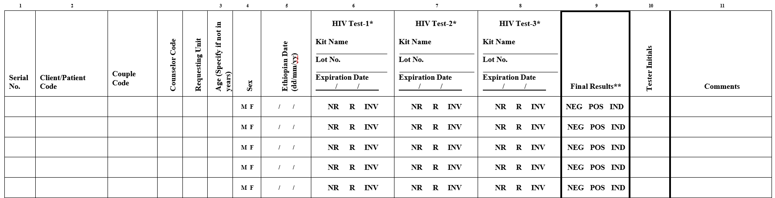
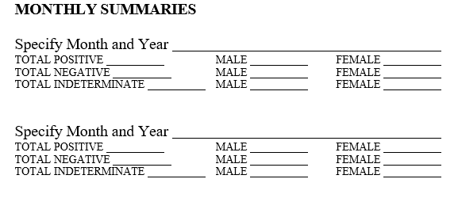
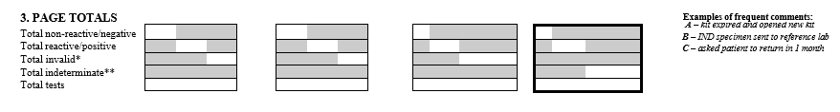
Standard RHT logbook implemented in Ethiopia

Slide 4
What was the role?
Ensured Adherence to testing algorithm
Helps to identify training needs and Focused mentorship

Slide 5
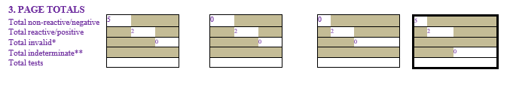
What was the role?
Ensure Kit information Validity
Determine INV & IND rate
Estimate Kit consumption
7
2
2

Slide 6
What was the role?
Data review on monthly bases

Slide 7
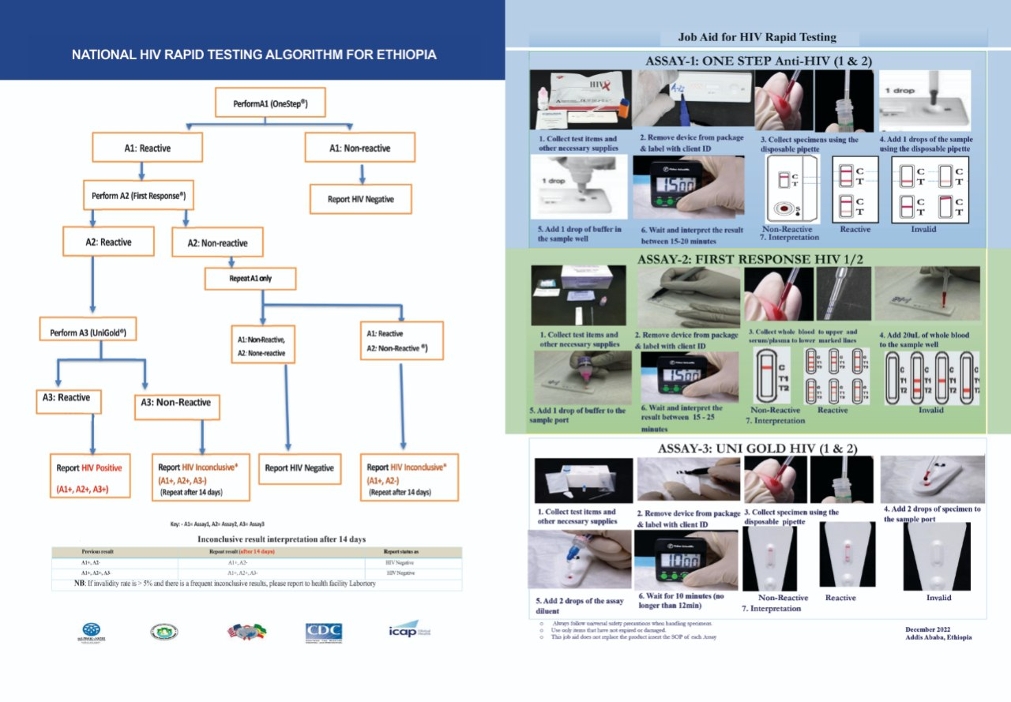


RHT capacity building activities done
TOT trainings on RHT Algorithm provided for regional reference laboratory experts
Basic RHT training provided for SDPs
SOPs/JA printed and distributed
Mentorship on RTH testing and recording

Slide 8
Rollout limitations
Even though printed and distributed to RHBs, Standard logbook was utilized at only selected SDPs like VCT.
  Before the introduction of this standard logbook, HIV rapid testing data was captured integrated with other clinical information using OPD and IPD abstracts/registers.
  Only final HIV status was documented
  Lack the opportunity to ensure adherence to testing algorithm/testing kit validity and estimate kit consumption rate.
Notes:
As

Slide 9

Lesson learned
An opportunity to monitor the quality of HIV testing service
Helps to quantify, procure and distribute the required amount of RTK based on the actual consumption rate
Helps to Audit RTKs used

Slide 10




Moving forward
Create demand among different stake holders and decide to implement at all SDPs
Provide RT CQI refresher trainings
Print and distribute
Conduct onsite evaluation and supervision

Slide 11
Thank you

